Slide 1

AHP Analysis
Co-Sub
Co-Sub
21102052 Lee Jeong-yun | 21102044 Oh Seyeon | 21102050 Lee In-sun

Slide 2

Contents
1
Decision Tree
2
Weights
3
Scores
4
Final Result

Slide 3

Decision Tree
1
Start our business
Financial
factor
Technological
factor
Service
factor
B/C ratio
Security
Optimize
AI to find
personal
color
Data
Analysis
(customer review
Convenience
Of
individual
Saving
Conversion
cost of
choosing
lip color
Expandability
Start our business
Do not Start our business

Slide 4
2
Weight - Seyeon
Overall
Step 1 | Financial Factor | Technological Factor | Service Factor
Financial Factor | 1 | 0.142857143 | 0.333333333
Technological Factor | 7 | 1 | 5
Service Factor | 3 | 0.2 | 1
Total | 11 | 1.342857143 | 6.333333333
Step 4 | Consistency Vector
Financial Factor | 3.01365532
Technological Factor | 3.141081563
Service Factor | 3.042719129
Lambda | 3.06581867
Step 2 | Financial Factor | Technological Factor | Service Factor | Resulting Priorities
Financial Factor | 0.090909091 | 0.106382979 | 0.052631579 | 0.083307883
Technological Factor | 0.636363636 | 0.744680851 | 0.789473684 | 0.723506057
Service Factor | 0.272727273 | 0.14893617 | 0.157894737 | 0.19318606
Total | 1 | 1 | 1 | 1
CI of all | 0.032909335
CR of all | 0.056740233
RI | 0.58
Step 3 | Financial Factor | Technological Factor | Service Factor | Weighted Sum Vector
Financial Factor | 0.083307883 | 0.103358008 | 0.064395353 | 0.251061244
Technological Factor | 0.58315518 | 0.723506057 | 0.9659303 | 2.272591537
Service Factor | 0.249923649 | 0.144701211 | 0.19318606 | 0.58781092

Slide 5
2
Weight – Jeongyun
Overall
Step 1 | Financial Factor | Technological Factor | Service Factor
Financial Factor | 1 | 0.142857143 | 0.2
Technological Factor | 7 | 1 | 2
Service Factor | 5 | 0.5 | 1
Total | 13 | 1.642857143 | 3.2
Step 4 | Consistency Vector
Financial Factor | 3.003086664
Technological Factor | 3.024416136
Service Factor | 3.015028178
Lambda | 3.014176993
Step 2 | Financial Factor | Technological Factor | Service Factor | Resulting Priorities
Financial Factor | 0.076923077 | 0.086956522 | 0.0625 | 0.075459866
Technological Factor | 0.538461538 | 0.608695652 | 0.625 | 0.590719064
Service Factor | 0.384615385 | 0.304347826 | 0.3125 | 0.33382107
Total | 1 | 1 | 1 | 1
CI of all | 0.007088496
CR of all | 0.012221545
RI | 0.58
Step 3 | Financial Factor | Technological Factor | Service Factor | Weighted Sum Vector
Financial Factor | 0.075459866 | 0.084388438 | 0.066764214 | 0.226612518
Technological Factor | 0.528219064 | 0.590719064 | 0.66764214 | 1.786580268
Service Factor | 0.377299331 | 0.295359532 | 0.33382107 | 1.006479933

Slide 6
2
Weight - Insun
Overall
Step 1 | Financial Factor | Technological Factor | Service Factor
Financial Factor | 1 | 0.5 | 0.2
Technological Factor | 2 | 1 | 0.125
Service Factor | 5 | 6 | 1
Total | 8 | 7.5 | 1.325
Step 4 | Consistency Vector
Financial Factor | 2.969527306
Technological Factor | 3.004896313
Service Factor | 3.100771839
Lambda | 3.025065153
Step 2 | Financial Factor | Technological Factor | Service Factor | Resulting Priorities
Financial Factor | 0.125 | 0.066666667 | 0.150943396 | 0.114203354
Technological Factor | 0.25 | 0.133333333 | 0.094339623 | 0.159224319
Service Factor | 0.625 | 0.8 | 0.754716981 | 0.726572327
Total | 1 | 1 | 1 | 1
CI of all | 0.012532576
CR of all | 0.02160789
RI | 0.58
Step 3 | Financial Factor | Technological Factor | Service Factor | Weighted Sum Vector
Financial Factor | 0.114203354 | 0.079612159 | 0.145314465 | 0.339129979
Technological Factor | 0.228406709 | 0.159224319 | 0.090821541 | 0.478452568
Service Factor | 0.571016771 | 0.955345912 | 0.726572327 | 2.25293501

Slide 7
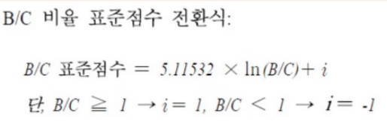
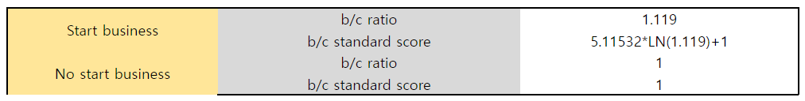
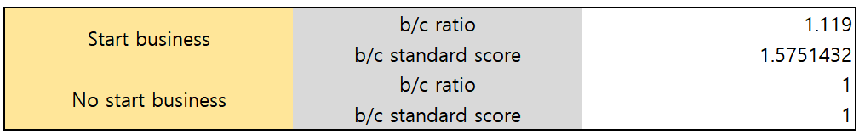
2
Weight
Financial

Slide 8
2
Weight - Seyeon
Technological
Step 1 | Security | Opimize AI | Data Analysis
Security | 1 | 0.166666667 | 0.25
Opimize AI | 6 | 1 | 2
Data Analysis | 4 | 0.5 | 1
Total | 11 | 1.666666667 | 3.25
Step 4 | Consistency Vector
Security | 3.002393386
Opimize AI | 3.015885624
Data Analysis | 3.009359251
Lambda | 3.009212753
Step 2 | Security | Opimize AI | Data Analysis | Resulting Priorities
Security | 0.090909091 | 0.1 | 0.076923077 | 0.089277389
Opimize AI | 0.545454545 | 0.6 | 0.615384615 | 0.586946387
Data Analysis | 0.363636364 | 0.3 | 0.307692308 | 0.323776224
Total | 1 | 1 | 1 | 1
CI of all | 0.004606377
CR of all | 0.007942029
RI | 0.58
Step 3 | Security | Opimize AI | Data Analysis | Weighted Sum Vector
Security | 0.089277389 | 0.097824398 | 0.080944056 | 0.268045843
Opimize AI | 0.535664336 | 0.586946387 | 0.647552448 | 1.77016317
Data Analysis | 0.357109557 | 0.293473193 | 0.323776224 | 0.974358974

Slide 9
2
Weight - Jeongyun
Technological
Step 1 | Security | Opimize AI | Data Analysis
Security | 1 | 0.166666667 | 0.25
Opimize AI | 6 | 1 | 2
Data Analysis | 4 | 0.5 | 1
Total | 11 | 1.666666667 | 3.25
Step 4 | Consistency Vector
Security | 3.002393386
Opimize AI | 3.015885624
Data Analysis | 3.009359251
Lambda | 3.009212753
Step 2 | Security | Opimize AI | Data Analysis | Resulting Priorities
Security | 0.090909091 | 0.1 | 0.076923077 | 0.089277389
Opimize AI | 0.545454545 | 0.6 | 0.615384615 | 0.586946387
Data Analysis | 0.363636364 | 0.3 | 0.307692308 | 0.323776224
Total | 1 | 1 | 1 | 1
CI of all | 0.004606377
CR of all | 0.007942029
RI | 0.58
Step 3 | Security | Opimize AI | Data Analysis | Weighted Sum Vector
Security | 0.089277389 | 0.097824398 | 0.080944056 | 0.268045843
Opimize AI | 0.535664336 | 0.586946387 | 0.647552448 | 1.77016317
Data Analysis | 0.357109557 | 0.293473193 | 0.323776224 | 0.974358974

Slide 10
2
Weight - Insun
Technological
Step 1 | Security | Opimize AI | Data Analysis
Security | 1 | 0.5 | 0.25
Opimize AI | 2 | 1 | 0.2
Data Analysis | 4 | 5 | 1
Total | 7 | 6.5 | 1.45
Step 4 | Consistency Vector
Security | 3.030434783
Opimize AI | 3.061417323
Data Analysis | 3.194848824
Lambda | 3.095566977
Step 2 | Security | Opimize AI | Data Analysis | Resulting Priorities
Security | 0.142857143 | 0.076923077 | 0.172413793 | 0.130731338
Opimize AI | 0.285714286 | 0.153846154 | 0.137931034 | 0.192497158
Data Analysis | 0.571428571 | 0.769230769 | 0.689655172 | 0.676771504
Total | 1 | 1 | 1 | 1
CI of all | 0.047783488
CR of all | 0.082385325
RI | 0.58
Step 3 | Security | Opimize AI | Data Analysis | Weighted Sum Vector
Security | 0.130731338 | 0.096248579 | 0.169192876 | 0.396172793
Opimize AI | 0.261462675 | 0.192497158 | 0.135354301 | 0.589314134
Data Analysis | 0.522925351 | 0.96248579 | 0.676771504 | 2.162182645

Slide 11
2
Weight - Seyeon
Service
Step 1 | Convenience of individual | Saving conversion cost | Expandability
Convenience of individual | 1 | 0.25 | 3
Saving conversion cost | 4 | 1 | 8
Expandability | 0.333333333 | 0.125 | 1
Total | 5.333333333 | 1.375 | 12
Step 4 | Consistency Vector
Convenience of individual | 3.012232416
Saving conversion cost | 3.038869258
Expandability | 3.004
Lambda | 3.018367225
Step2 | Convenience of individual | Saving conversion cost | Expandability | Resulting Priorities
Convenience of individual | 0.1875 | 0.181818182 | 0.25 | 0.206439394
Saving conversion cost | 0.75 | 0.727272727 | 0.666666667 | 0.714646465
Expandability | 0.0625 | 0.090909091 | 0.083333333 | 0.078914141
Total | 1 | 1 | 1 | 1
CI of all | 0.009183612
CR of all | 0.015833814
RI | 0.58
Step3 | Convenience of individual | Saving conversion cost | Expandability | Weighted Sum Vector
Convenience of individual | 0.206439394 | 0.178661616 | 0.236742424 | 0.621843434
Saving conversion cost | 0.825757576 | 0.714646465 | 0.631313131 | 2.171717172
Expandability | 0.068813131 | 0.089330808 | 0.078914141 | 0.237058081

Slide 12
2
Weight - Jeongyun
Service
Step 1 | Convenience of individual | Saving conversion cost | Expandability
Convenience of individual | 1 | 0.25 | 3
Saving conversion cost | 4 | 1 | 8
Expandability | 0.333333333 | 0.125 | 1
Total | 5.333333333 | 1.375 | 12
Step 4 | Consistency Vector
Convenience of individual | 3.012232416
Saving conversion cost | 3.038869258
Expandability | 3.004
Lambda | 3.018367225
Step2 | Convenience of individual | Saving conversion cost | Expandability | Resulting Priorities
Convenience of individual | 0.1875 | 0.181818182 | 0.25 | 0.206439394
Saving conversion cost | 0.75 | 0.727272727 | 0.666666667 | 0.714646465
Expandability | 0.0625 | 0.090909091 | 0.083333333 | 0.078914141
Total | 1 | 1 | 1 | 1
CI of all | 0.009183612
CR of all | 0.015833814
RI | 0.58
Step3 | Convenience of individual | Saving conversion cost | Expandability | Weighted Sum Vector
Convenience of individual | 0.206439394 | 0.178661616 | 0.236742424 | 0.621843434
Saving conversion cost | 0.825757576 | 0.714646465 | 0.631313131 | 2.171717172
Expandability | 0.068813131 | 0.089330808 | 0.078914141 | 0.237058081

Slide 13
2
Weight - Insun
Service
Step 1 | Convenience of individual | Saving conversion cost | Expandability
Convenience of individual | 1 | 0.333333333 | 0.13
Saving conversion cost | 3 | 1 | 0.25
Expandability | 6 | 5 | 1
Total | 10 | 6.333333333 | 1.38
Step 4 | Consistency Vector
Convenience of individual | 2.976435929
Saving conversion cost | 2.985796133
Expandability | 3.211935344
Lambda | 3.058055802
Step2 | Convenience of individual | Saving conversion cost | Expandability | Resulting Priorities
Convenience of individual | 0.1 | 0.052631579 | 0.094202899 | 0.082278159
Saving conversion cost | 0.3 | 0.157894737 | 0.18115942 | 0.213018052
Expandability | 0.6 | 0.789473684 | 0.724637681 | 0.704703788
Total | 1 | 1 | 1 | 1
CI of all | 0.029027901
CR of all | 0.050048105
RI | 0.58
Step3 | Convenience of individual | Saving conversion cost | Expandability | Weighted Sum Vector
Convenience of individual | 0.082278159 | 0.071006017 | 0.091611492 | 0.244895669
Saving conversion cost | 0.246834477 | 0.213018052 | 0.176175947 | 0.636028477
Expandability | 0.493668955 | 1.065090262 | 0.704703788 | 2.263463005

Slide 14
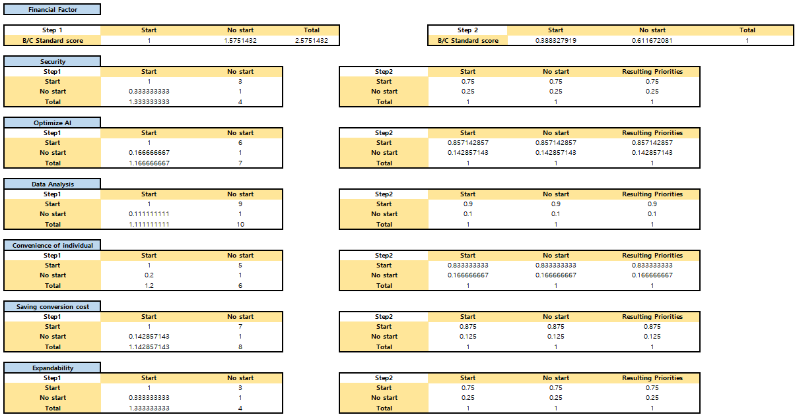
3
Score
Seyeon

Slide 15
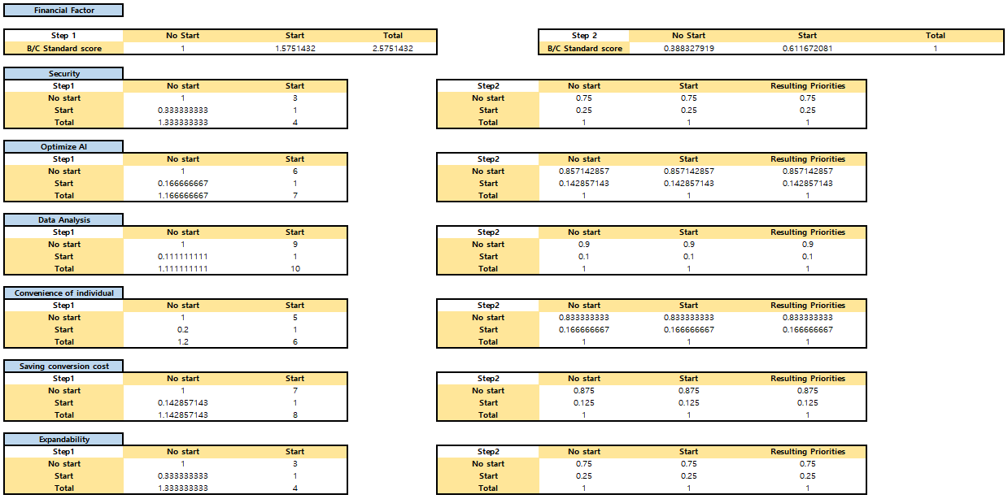
3
Score
Jeongyun

Slide 16
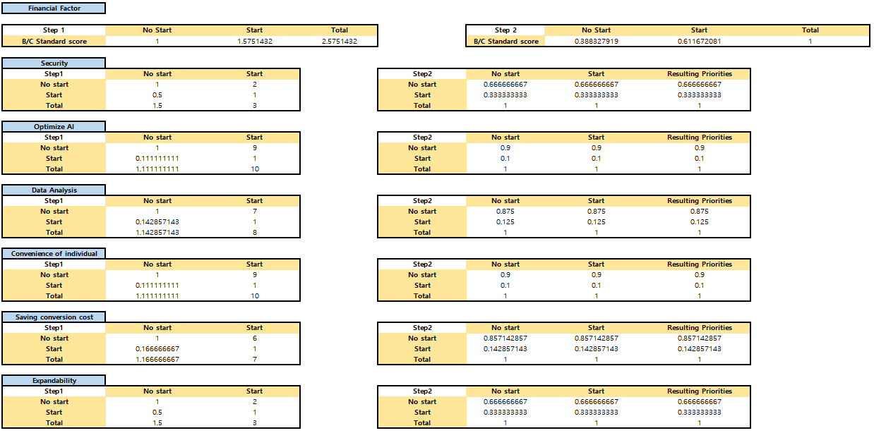
3
Score
Insun

Slide 17
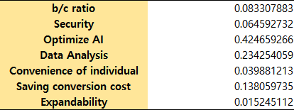
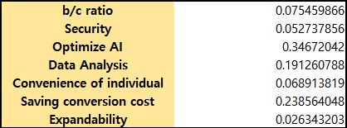
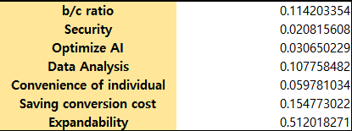
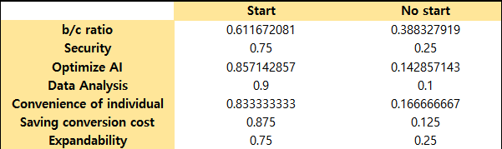
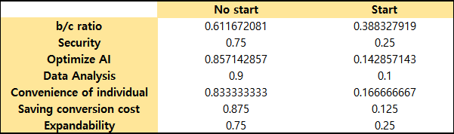
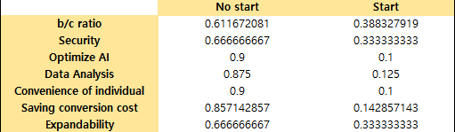
4
Aggregate Final Priorities
*Calculation of weight
Seyeon
Jeong-yun
In-sun
*Calculation of score
Seyeon
Jeong-yun
In-sun

Slide 18



4
Aggregate Final Priorities
*AHP Result = Calculation of weight $×$Calculation of score
Seyeon
Jeong-yun
In-sun

Slide 19
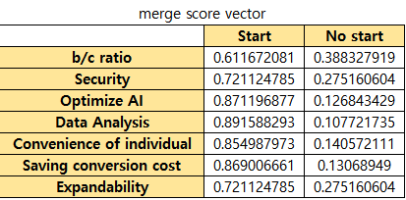
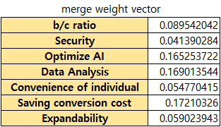
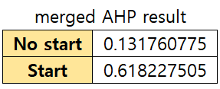
4
Aggregate Final Priorities
Merged Result
No start < Start

Slide 20
4
Aggregate Final Priorities
AHP result
 | AHP<0.45 | 0.45<=AHP<0.5 | 0.5<=AHP<0.55 | 0.55<=AHP
3 : 0 | - | - | Valid | Valid
2 : 1 | Feedback | Very Cautious | A Bit Cautious | Valid
1 : 2 | No Validity | A Bit Cautious | Very Cautious | Feedback
0 : 3 | No Validity | No Validity | - | -
Total
Start : No start
Starting Our Business is Valid Choice.

Slide 21
Thank you
Co-Sub
Co-Sub
21102052 Lee Jeong-yun | 21102044 Oh Seyeon | 21102050 Lee In-sun

